Slide 1
MacroPad
A multi-functional app for macros on launchpad
Free
Easy to use
Compatible with different launchpads

Slide 2
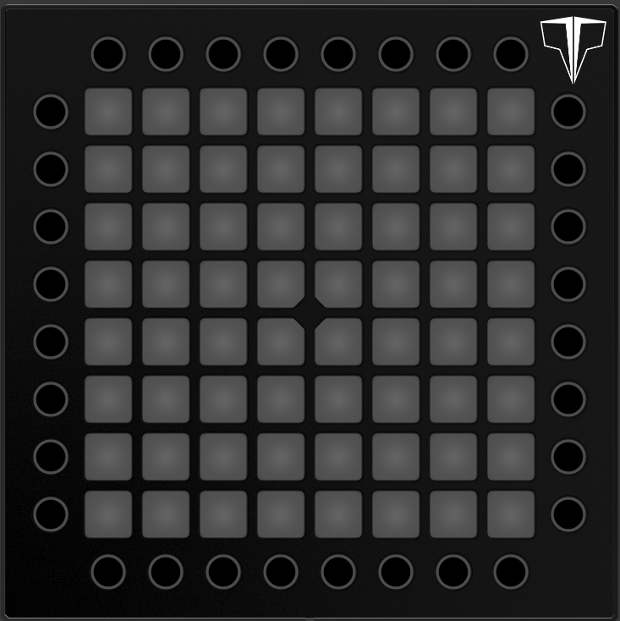
Games Controller
Exit Program
Esc
Gaming Preset
OBS Preset
Q
E
W
E
R
I
Alt + Tab
Shift
A
S
D
F
Ctrl
Sp
A
C
E
↑
←
↓
→

Slide 3
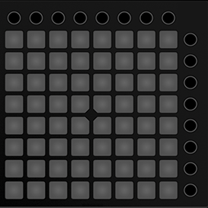
Games Controller
Exit Program
Esc
Gaming Preset
OBS Preset
Q
E
W
E
R
I
Alt + Tab
Shift
A
S
D
F
Ctrl
Sp
A
C
E
↑
←
↓
→

Slide 4
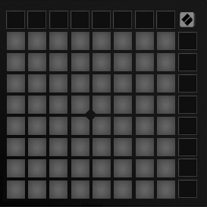
Games Controller
Exit Program
Esc
Gaming Preset
OBS Preset
Q
E
W
E
R
I
Alt + Tab
Shift
A
S
D
F
Ctrl
Sp
A
C
E
↑
←
↓
→

Slide 5
OBS Controller
Exit Program
(map your hotkeys in OBS respectively)
Ctrl +Shift + 1
1
Alt + Tab
Gaming Preset
Ctrl +Shift + 2
2
OBS Preset
Ctrl +Shift + 3
3
Ctrl +Shift + 4
4
Change scenes
Ctrl +Shift + 5
5
Ctrl +Shift + 6
6
Ctrl +Shift + 7
7
Ctrl + Shift + F8 (start stream)
Ctrl +Shift + 8
8
Ctrl + Shift + F9 (stop stream)

Slide 6
OBS Controller
Exit Program
(map your hotkeys in OBS respectively)
Ctrl +Shift + 1
1
Alt + Tab
Gaming Preset
Ctrl +Shift + 2
2
OBS Preset
Ctrl +Shift + 3
3
Ctrl +Shift + 4
4
Change scenes
Ctrl +Shift + 5
5
Ctrl +Shift + 6
6
Ctrl +Shift + 7
7
Ctrl + Shift + F8 (start stream)
Ctrl +Shift + 8
8
Ctrl + Shift + F9 (stop stream)

Slide 7
OBS Controller
Exit Program
(map your hotkeys in OBS respectively)
Ctrl +Shift + 1
1
Alt + Tab
Gaming Preset
Ctrl +Shift + 2
2
OBS Preset
Ctrl +Shift + 3
3
Ctrl +Shift + 4
4
Change scenes
Ctrl +Shift + 5
5
Ctrl +Shift + 6
6
Ctrl +Shift + 7
7
Ctrl + Shift + F8 (start stream)
Ctrl +Shift + 8
8
Ctrl + Shift + F9 (stop stream)

